Slide 1
RE for the Rest of Us: A Hands-On Introduction to Hardware and Software RE
Sydney Johns

Slide 2
About Me - Sydney Johns
PhD Student in Computer Science @ VT Innovation Campus
Intern, Reverse Engineering team @ JHU APL
Research: post-quantum cryptography, side-channel attacks, cybersecurity & ML.
Interests: Painting, Anime, Animal Crossing, Sims, Shopping

Slide 3
Agenda
Introduction to Reverse Engineering
Hardware Reverse Engineering
Exercise - Continuity Test on Arduino Boards
Exercise - Chip ID on Arduino Boards
Software Reverse Engineering
Exercise – Flash Firmware to Arduino Uno
Tutorial – Analyze C Code in Ghidra
Takeaways & Resources
Notes:
We’ll start with an overview of reverse engineering.
Then, we’ll dive into hands-on hardware RE using the Arduino Uno.
After that, we’ll explore software RE: flashing firmware and analyzing it in Ghidra.
Finally, I’ll leave you with tools, takeaways, and resources to continue learning

Slide 4
What is reverse engineering?
Reverse Engineering (RE) is the process of analyzing an existing item to extract technical information required to reproduce or understand it.
It typically involves physical access to hardware or software and aims to recreate functionality, structure, or documentation.
Defense Logistics Agency. (n.d.). Reverse Engineering. Defense Logistics Agency Aviation. Retrieved July 14, 2025, from https://www.dla.mil/Aviation/Offers/Engineering/Reverse-Engineering/
Notes:
Reverse engineering means taking something apart to understand how it works.
The goal isn’t just replication—it’s also understanding structure, security, and logic.
It can apply to hardware & software,

Slide 5
Hardware Reverse Engineering
The process of disassembling and understanding a physical device or system. It involves taking apart the hardware to examine its components.
LaCASA. (n.d.). MSP430 software reverse engineering [Lecture notes]. University of Alabama in Huntsville. https://lacasa.uah.edu/images/Upload/teaching/cpe323/lectures/lw13_cpe323_MSP430_SoftwareReverseEngineering_Text.pdf
Notes:
“This is useful for security audits, system replication, or legacy system maintenance.”
Hardware RE focuses on physical components—chips, ports, connections.
We start by examining devices externally, then dig into internal circuitry.

Slide 6

Step 0: Disassembly
Use specialized tools and a heat gun to carefully remove outer casing and components.
Document each step with photos for later reference.
Notes:
Carefully open the device using appropriate tools and record each step for reference. Keep things you take apart in some order so that when you rebuild you can easily undo what you did.

Slide 7
Step 1: Identify Components
Inspect the board and note all part numbers.
Look up datasheets for each chip to understand function and pinout.
Use Google reverse image search or sites like Octopart for component identification.
Notes:
Once open, identify each chip or module.
Read the labels or part numbers—they reveal what each part does.
This step often leads to datasheets, which are key to understanding functionality.

Slide 8
Exercise: Catalogue IC Components
On Arduino board pick one component (A, B, C, D)
Write down the part number printed on the chip.
Google the part number and find the datasheet.
You may also search on https://octopart.com/
Answer questions:
What does the chip do?
How many pins does it have?
What interfaces or protocols does it use?
Notes:
Choose a chip, write down the part number, and look up its datasheet.
Identify its function, number of pins, and protocols.
This teaches you to read PCBs and interpret component roles.

Slide 9
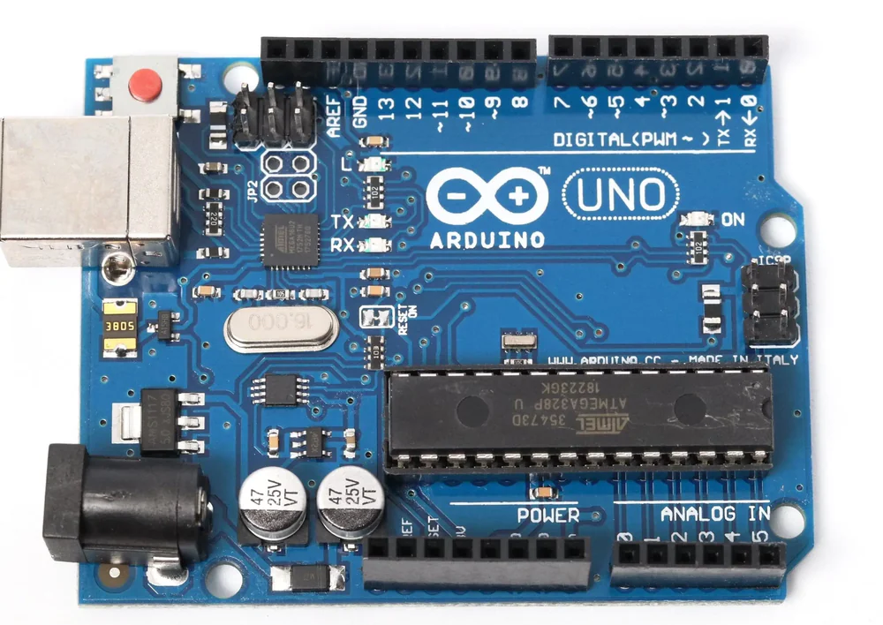
A
D
B
C

Slide 10
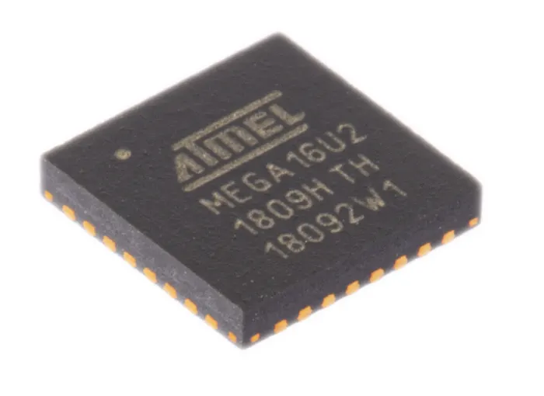
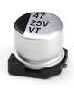
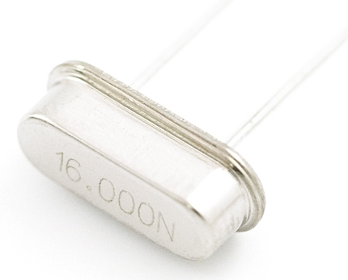
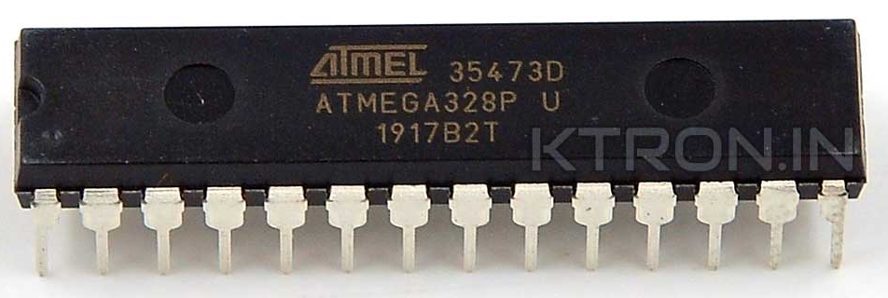
A
C
B
D

Slide 11
Solution: Catalogue IC Components
ATmega328/P
The brain of the Arduino Uno. It runs user code, handles I/O, and controls peripherals.
28 pins
UART (Serial), Digital I/O
16 MHz Crystal Oscillator
Provides the clock signal that drives the timing of the microcontroller.
2 pins
None — it's a passive timing component.
47 25V VT Capacitor
Smooths voltage, filters noise, or stores charge.
2 pins
None — it’s an analog timing component.
ATmega16U2
USB-to-serial converter
32 pins
UART (Serial), GPIO, USB
Datasheets available at: https://github.com/syd-kiwi/re-arduino-uno

Slide 12

Step 2: Locate Voltage and Ground
Use a multimeter to measure voltages at different points.
Identify power and ground pins.
Check for continuity to trace circuit paths.

Slide 13
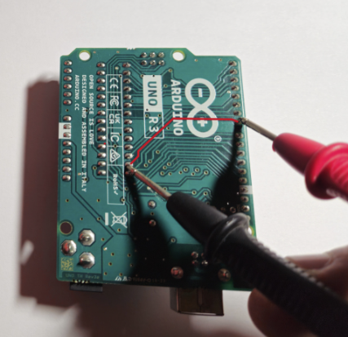
Exercise: Trace Continuity on Arduino
Flip the Arduino board over so you can see the soldered traces.
Choose a single trace or line to test.
Place one probe on each end of that line—where the pins or solder joints are.
Use a multimeter in continuity mode — if the line is intact, you'll hear a beep.
Notes:
Flip the board to see soldered traces.
Pick one trace and test both ends with a multimeter.
A beep confirms continuity—useful for debugging or mapping circuits.

Slide 14
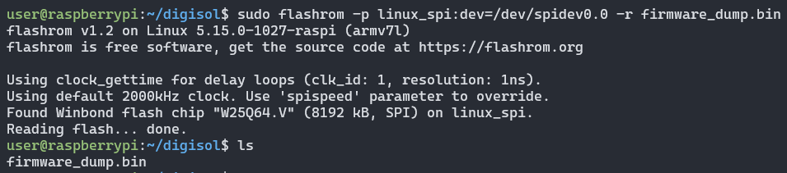
Step 3: Flash Dumping Prep
Identify memory chips or microcontrollers.
Look for connection points like test pads or headers.
Quarkslab. (2018, January 11). Flash dumping – Part I. Quarkslab Blog. https://blog.quarkslab.com/flash-dumping-part-i.html
Notes:
sudo flashrom -p linux_spi:dev=/dev/spidev0.0 -r firmware_dump.bin
sudo: Run as superuser (required for hardware access).
flashrom: The tool used for reading/writing flash memory.
-p linux_spi:dev=/dev/spidev0.0: Specifies the programmer type (linux_spi) and the SPI device to use (/dev/spidev0.0).
-r firmware_dump.bin: Tells flashrom to read from the chip and save the contents to firmware_dump.bin.
flashrom was used on Linux kernel running on a Raspberry Pi
Flash memory was successfully read and saved into a binary file named firmware_dump.bin.
Analyze the dump with tools like binwalk

Slide 15
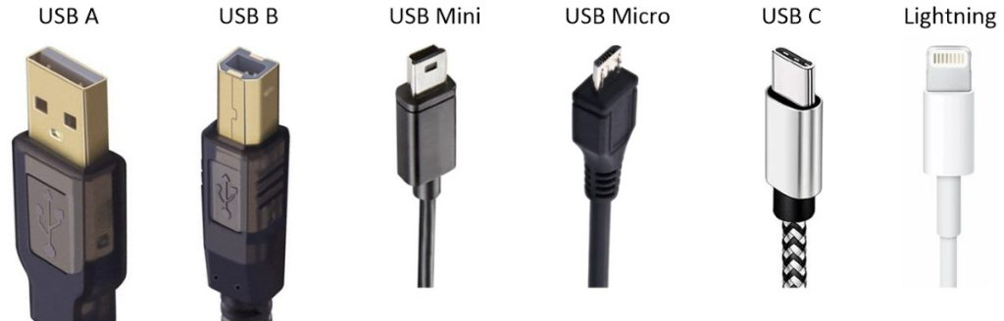
Step 4: Locate Diagnostic Ports
Common diagnostic/debug ports: JTAG, UART & USB
These may allow direct access to memory or system logs.
USB - B Socket: The USB socket on the UNO has two functions. One is for communication, to load the firmware into the Arduino with the help of the bootloader. The second is to power the Arduino.

Slide 16
Step 5: Dump and Analyze Flash
Use flash dumpers, SPI readers, or UART/JTAG tools to extract firmware.
Analyze firmware using static tools (Ghidra, binwalk) and dynamic testing environments.
Understand the system behavior and security posture from the firmware content.

Slide 17
Software Reverse Engineering
The process of examining and analyzing existing software to understand its structure, functionality, and design, often without access to the original source code.
Legal Information Institute. (n.d.). Reverse engineering. Cornell Law School. https://www.law.cornell.edu/wex/reverse_engineering
Notes:
Software RE is about understanding binaries without source code.
This helps uncover vulnerabilities, undocumented features, or logic errors.

Slide 18

Step 1: Information Gathering
Collect all available artifacts: executables, binaries, config files, logs, firmware dumps, and any relevant documentation.
Notes:
First, collect everything you can: binaries, logs, firmware, config files.
The more data you have, the better the analysis will be.

Slide 19

Step 2: Disassembly or Decompilation
Disassembly: Converts machine code to readable assembly.
Decompilation: Translates low-level code into C-like source.
Tools: Ghidra, IDA Pro, Radare2, Hopper.

Slide 20
Step 3: Code Analysis
Static Analysis: Understand the code without executing it (e.g., control flow, functions, logic).
Dynamic Analysis: Run the program to observe behavior (e.g., tracing, breakpoints, debugging).
Goal: Reconstruct algorithms, logic, and architecture.

Slide 21
Step 3: Code Analysis
In this section we want to identify…
Entry point (main)
Functions and control flow
Strings, constants, and memory access
Variables and register usage
Notes:
These patterns help you reverse the program’s purpose.

Slide 22
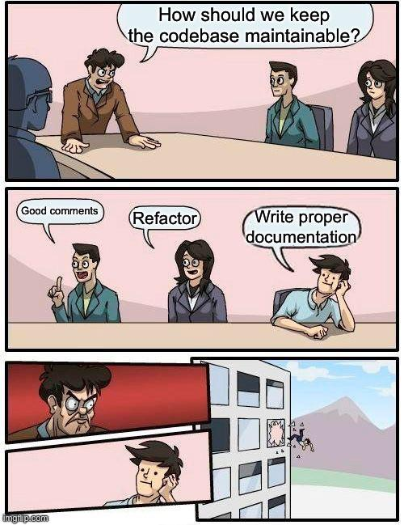
Step 4: Documentation
Record findings using diagrams, comments, and structure charts.
Common tools: Flowcharts, call graphs, data flow diagrams, and pseudo-code

Slide 23
Exercise: Flash Software onto Arduino
Flash the provided .ino file to your Arduino board using the Arduino Web Editor. Go to my repo: https://github.com/syd-kiwi/re-arduino-uno & Download Arduino-test.ino file
Open https://cloud.arduino.cc/
Select Get Started Free > Create Account
Create New > Sketch
File > Add > Import File > Arduino-test.ino
Plug in the board to your computer
Select Device > Compile with Check Box > Flash with Arrow

Slide 24
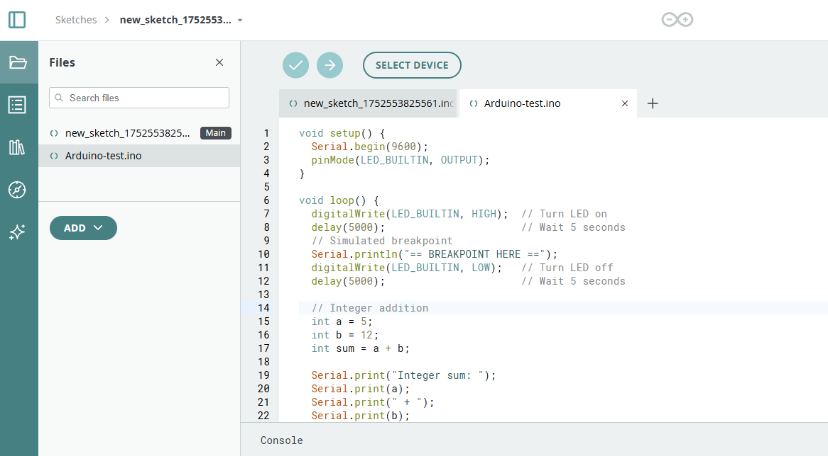

Slide 25
Tutorial: Analyze C Code in Ghidra
Those interested can download Ghidra here & try: https://github.com/NationalSecurityAgency/ghidra/releases
Locate the main() function in the decompiler
Identify:
Integer addition: int a = 5; int b = 12; int sum = a + b;
LED control via digitalWrite(LED_BUILTIN, HIGH/LOW)
Delay functions (look for timing-related calls)
Hex addition:0x03 + 0x07, and 0x04 + 0x0A
Observe how variables are mapped to registers or memory
Notes:
Learn how Ghidra represents basic C logic in assembly and memory.
Load the compiled firmware into Ghidra.
Find main() and look for key patterns: - Integer operations - LED toggling with digitalWrite() - Delays and hex math
Ghidra lets us trace how C translates into low-level operations.

Slide 26
Tips & Takeaways
Learn a few popular tools—Ghidra, Binwalk, QEMU, and GDB—Most come preinstalled on Kali Linux and make excellent resume builders.
You don’t need to be an expert — if you can write simple C, you can start reversing it and doing independent projects.
Practice makes patterns — the more you reverse, the more familiar code and circuit behaviors will become.
Notes:
Learn a few popular tools—Ghidra, Binwalk, QEMU, and GDB—which help bridge the gap between machine code and human-readable code. Most come preinstalled on Kali Linux and make excellent resume builders.
You don’t need to be an expert — if you can write simple C, you can start reversing it and doing independent projects.
Always document your reverse engineering process. Notes, screenshots, and code comments make it easier to replicate, explain, and improve your work.
Practice makes patterns — the more you reverse, the more familiar code and circuit behaviors will become.

Slide 27
Learning Resources
x86/x64 Reversing Series by 0xInfection 🔗 https://0xinfection.github.io/reversing/ Clean and modern blog-style walkthroughs on basic x86/x64 reversing, stack layout, function calls, and binary analysis using Ghidra and other tools.
Getting Started With Reverse Engineering 🔗 https://www.youtube.com/watch?v=K-oowwtK_8Q A beginner's introduction to reverse engineering, disassemblers, decompilers, and inspecting .NET code.

Slide 28
Thank you
Sydney Johns
https://www.linkedin.com/in/sydney-johns/
Notes:
Thanks for attending!
Connect with me on LinkedIn or explore my repo for hands-on practice.
Feel free to reach out if you're curious about learning RE or getting involved in security research.

